Slide 1
Office Website Training in Optimizely
Web Services
Max Pugh, Web Services Supervisor
Christopher Watley, Web Specialist
Tyrell Prout, Web Specialist
Angela Alcain, Web Specialist
Daniel Clark, Web Specialist
websupport@pgcps.org | 301-952-6001

Slide 2
Agenda
Visitors: Why such the hullabaloo?
Content Rules:
Think First, Edit Later
Ownership
Text
Accessibility
Editing In Episerver (Optimizely):
Logging in/Experience Editor setup
Navigation and Asset Panes
Shared content
Pages and Blocks
  District General Detail Page > Office Directory
  Other types of pages
  Using blocks to build a page
Managing Media (Files and Images)

Slide 3

Visitors: Why such the hullabaloo?

Slide 4
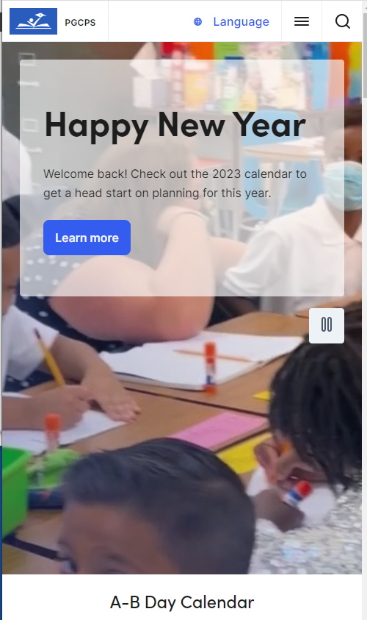
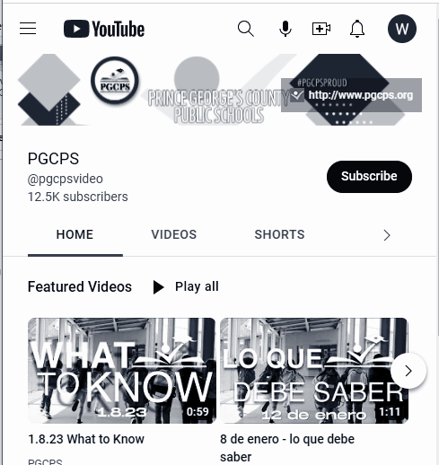
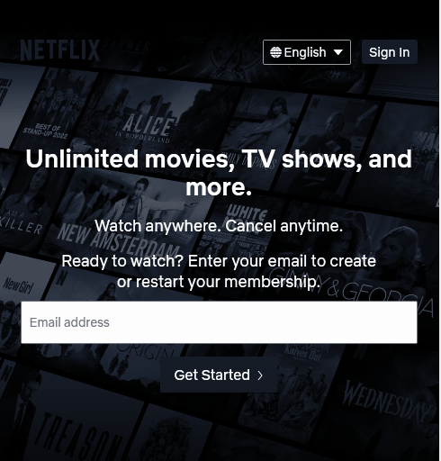
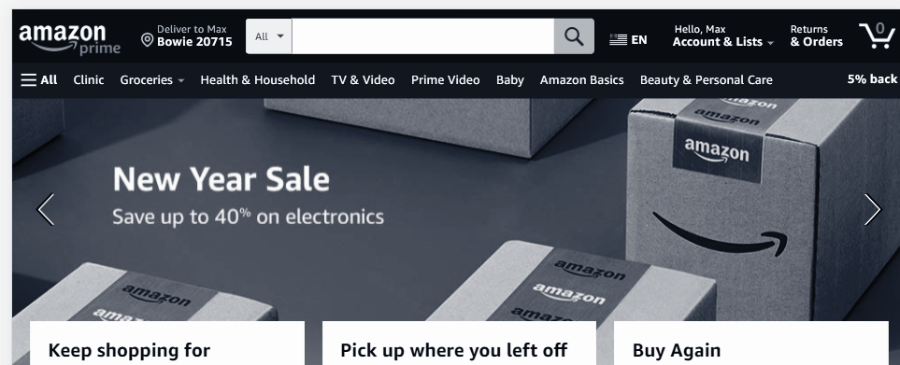
Website Usability
Jakob's Law
Users spend most of their time on other sites. This means that users prefer your site to work the same way as all the other sites they already know.

Slide 5

Website Usability
Hick’s law
States that the time it takes to make a decision increases with the number and complexity of choices present. The more the number of choices, the greater the time taken to come to a decision. In other words, there is a direct correlation between choices and time.

Slide 6
How do people view your site?
75% of new visitors come to your site on a mobile device
45% will never click on anything
Mobile users spend 20% less time on your site than a desktop user
65% of visitors remain on your site for less than 10 seconds
64% of visitors come to your site from google search results

Slide 7

Content Rules!

Slide 8

Content Rules: Think First, Edit Later
Who is your audience?
Staff, Students, Parents, Community Members, State and County Officials, Potential Households, Daycare Providers, Vendors, Organizations
What are people asking for?
Calls, emails, social media, surveys

Slide 9

Content Rules: Don’t Confuse Them
Is your information for the public or for staff?
Public website or Google site/Staff Portal
Is your topic/program /content familiar?
Commonly named?
No need for explanation?
Is it PGCPS or MSDE-jargon?
Don’t assume that visitors know what you are talking about. Tell them in plain language.
How would people search for it?
It must have a searchable, plain language title and content that would be found using common search terms. Visitors use what is familiar to themselves.

Slide 10

Content Rules: Ownership
Is it yours?
Only post content that you have the rights to post
If someone tells you to post something that you (your office or school) did not create, then you should link to the source; do not upload it to Opti or Google docs, etc.
Find or ask for the source and insert a hyperlink to the content
Warning: uploading commercial content that you did not create or have permission to upload is a violation of copyright law. This costs PGCPS $$$!
Applies to all digital channels - websites, flyers, social media

Slide 11

Content Rules: Text Mostly - Images with No Text
Text is easiest and most accessible to all devices and vision abilities
Images should not convey important information; use a decoration only
If using an image with text in it, make sure the text in the image is included as text next to or around that image
Applies to all digital channels - website, social media, videos, etc.
Google translate does not translate words in images

Slide 12
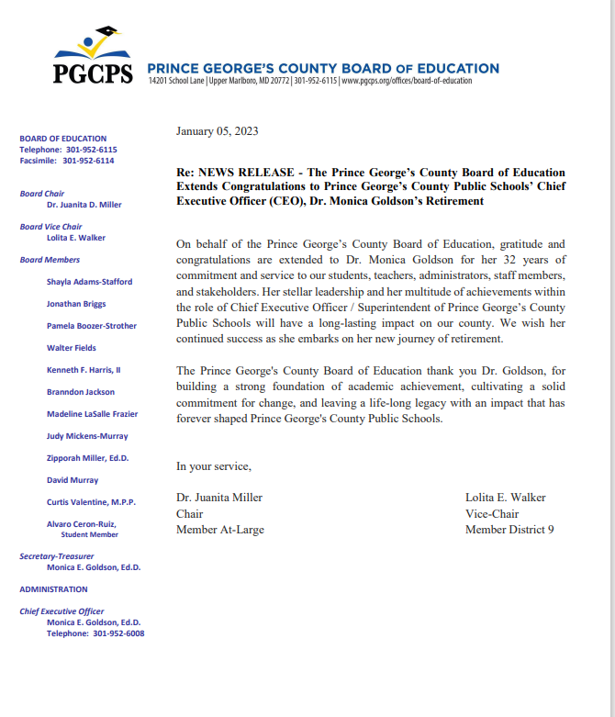
Content Rules: What about PDFs?
When do you encounter PDFs in your personal life?
  Official docs like mortgage applications, bank docs
  Manuals for appliances
  Studies, research, reports
  PGCPS
Remember, visitors want information fast and do not want to download a PDF where they have to pinch and zoom, and cannot search, copy or translate on the fly.
Are your PDFs accessible to visitors with vision-impairment? Use the Accessibility checker in Acrobat Pro DC.

Slide 13
Takeaways
Keep your visitor in mind
Give them what they want, how they want it
Search is critical
Watch out for copyright violations
Keep content in text format as much as possible
Avoid text in images
Do you really need a PDF?

Slide 14
Editing in Episerver (Optimizely)
Training Course Materials
Login to Optimizely

Slide 15
Logging in/Experience Editor setup

Slide 16

Logging in/Experience Editor setup
Login at www.pgcps.org/weblogin with your PGCPS email address and password
Click the pins in the left (navigation) pane and right (assets pane)
Click the gadget icon in the left pane and select add gadget (Analytics)
Click the gadget icon in the right page and select add gadget (Recent)
Click the gadget icon in the right pane and select rearrange gadgets.
Drag the recent gadget to the top of the pane, remove the forms gadget.
Click the gadget icon in the right pane and de-select rearrange gadgets.
Optimizely: Setting Up the Experience Editor (Video)

Slide 17
Exploring the Navigation and Asset Panes

Slide 18
Exploring the Navigation and Asset Panes
In the bottom of the left navigation pane, select your office’s project from the list and click overview.
In the navigation pane find your office’s home page under offices.
Check the information on the info tab to make sure it is correct
In the asset pane, find your office’s folder. Look in the blocks folder. Notice the different kinds of blocks.
Click on the media tab in the asset pane. Look in your office’s docs folder to see your office’s documents.

Slide 19
The Office Home Page
(District Office Detail Page)

Slide 20
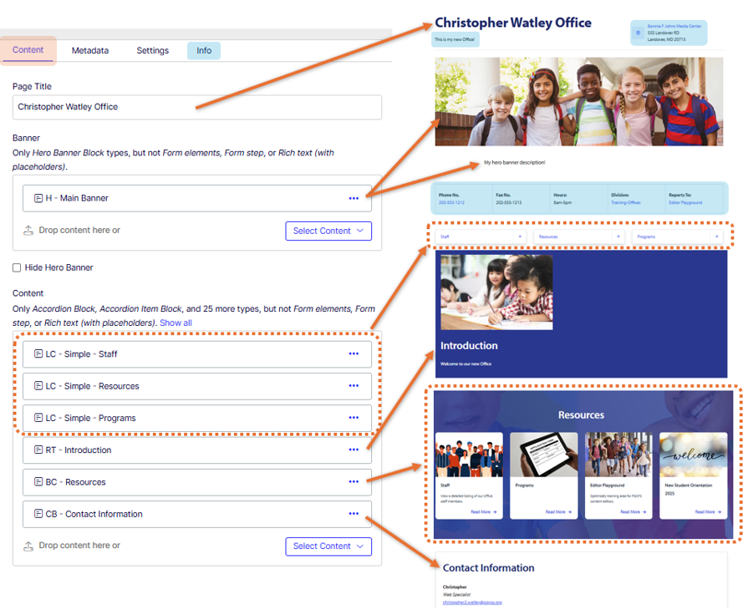
District Office Detail Page Overview
Tab: Content
  Page Title
  Banner
  Hide Hero Block
  Blocks

Slide 21
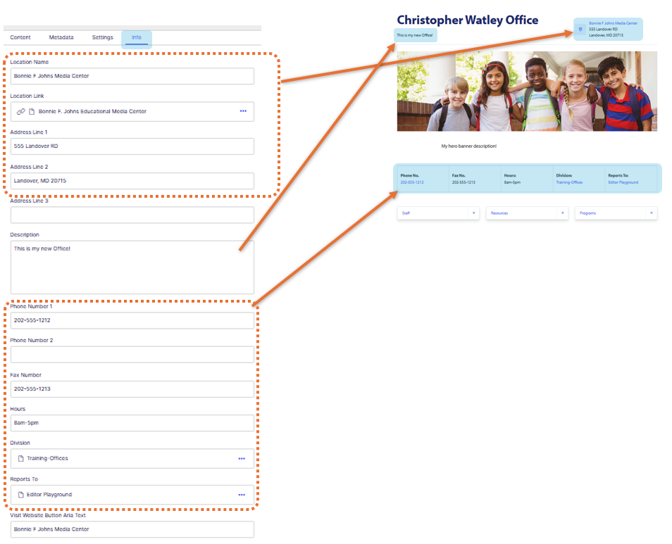
District Office Detail Page Overview
Info tab: Properties
Location Name
Location Link
Address Line (1, 2, 3)
Description
Phone Number (1 & 2)
Fax
Hours
Division
Reports To

Slide 22
Doing a quick edit on an existing page

Slide 23

Doing a quick edit on an existing page
Make sure you are logged into Optimizely
Navigate to the page you want to edit (you should see the blue Edit Page) button in the upper right corner
Click the blue Edit page button
Select the block you wish to edit
Use the options menu to select edit
Make changes
Submit for review or publish

Slide 24
Creating a Page

Slide 25
Creating a Page
Using the options menu, select “New Page”
Select Landing Page
Title the page “Your Name Page”
Click on the Preview icon to preview your page
Optimizely: Creating a Web Page with Text (Video)

Slide 26
Creating a Rich Text Block

Slide 27
Creating a Rich Text Block
Select the Blocks tab and the Blocks folder in the Asset Pane
From the options menu on the Blocks folder, select “New Block”
Select “Rich Text Block”
Title the block “RT - Your Name”
Copy and paste text from the document (rich text to be copied)
Clean up the text formatting

Slide 28
Putting the Page and Block Together

Slide 29
Putting the Page and Block Together
Go to the overview of your project
Open “Your Name Page”
From the Recent Items or Assets gadgets, drag the RT - Your Name block onto the content area.
Preview your page
Toggle the preview off and click on the metadata tab
In the Assets gadget, select media tab and search for “students”
Select “T-student-volunteers” from the list and drag it into the Thumbnail Image area
Type “My First Page” in the MetaTitle area
Preview your page

Slide 30
There’s even more!
Using the page somewhere
Using shared content
  Supportive Pages and Blocks
  Is your content being shared?
Media assets management
  Naming assets (docs, images)
  Adding assets
  Replacing assets
Publishing content
  With translation

Slide 31
Need additional help?
Sign up for an appointment
Create a Web Support Ticket
Contact a team member via email websupport@pgcps.org !

